Slide 1

Envisioning 21st Century Mixed-Initiative Operations for Energy Systems
Roger Lew ¹, Ronald L. Boring ², Thomas A. Ulrich ²
1 University of Idaho
Moscow, ID, USA
2 Idaho National Laboratory
Idaho Falls, ID, USA

Slide 2


1992 London Ambulance Service
6.8 Million residents
2,500 calls per day
445 Ambulances from 70 stations

Slide 3
1992 London Ambulance Service
In 1992, the London Ambulance Service deployed a computerized dispatch system in an effort to reduce response time to within three minutes.
The system was a spectacular failure, resulting in multiple units being sent to some locations while neglecting others.
Within 8-days the system completely stopped working
The system was attributed as causing as many as 46 deaths.

Slide 4
Why did LAS fail?
Causes identified as:
hardware that was under specified for the application
development that went to a low bidder who underestimated the work required
lack of commissioning and stress testing
The software contained a memory leak that ultimately crippled the system.
LAS now serves as a warning to placing too much trust in machines

Slide 5
2021 Uber
Algorithmically routes 93 million monthly users
Manages 3.5 million drivers
Uber Eats generated $4.8 billion in revenue for 2021 implying Uber delivered hundreds of millions of meals

Slide 6
Uber and Automation
Reliance on hands-off automation and artificial intelligence
“machine learning as the heart of almost every aspect of Uber.”
Artificial Intelligence is used to:
optimize ride sharing (where more than one set of passengers share a vehicle)
to identify fake accounts
improve routing
provide better prediction to volatility around historical events.
Why did the LAS fail and Uber succeed?

Slide 7
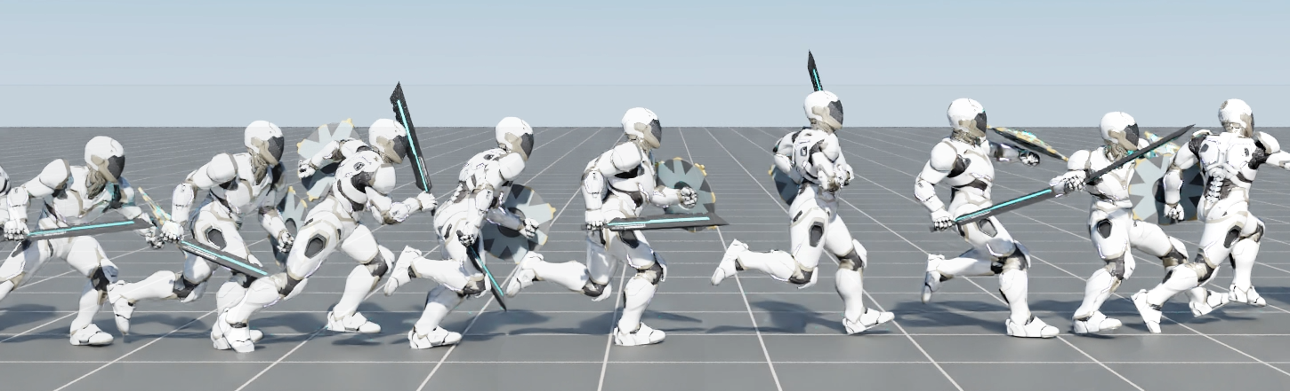
Progression of Artificial Intelligence
Decompose a problem and design a hand-coded solution (e.g. LAS)
Hand-code systems and use machine learning to optimize them
Use machine identify the features
Use Machine learning to learn system and optimize
Meta-learning AI has found that goal shifting is key to success
By changing goals algorithms continue to adapt
Likewise, changing the environment is also important to meta-learning

Slide 8
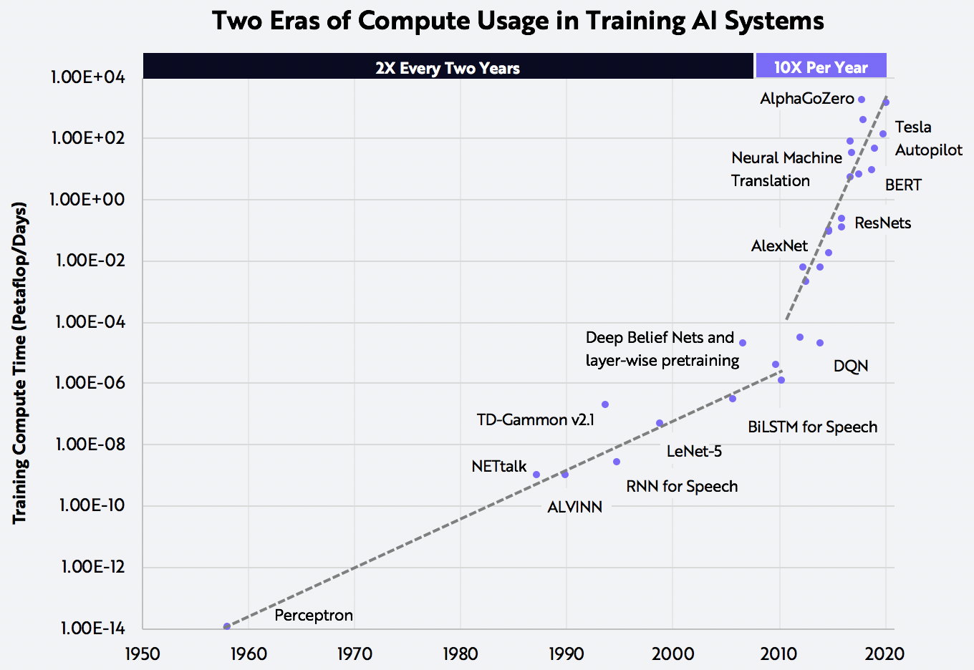
Concurrent trends in computation
The cost of training AI is improving at 50x the pace of Moore's Law.
AI applications are becoming both ubiquitous and invisible.
E.g. Adobe Photoshop

Slide 9
Mixed Initiatives Operations
Internet of things, more sensors and data
Potential for efficiency, cost-savings, improved reliability, resilience, performance
How to take advantage of interconnectivity?
Tasking AI with micro-second to second decisions to monitor distribution and generation and conduct automated switching is likely the only option.
Human and machine teaming is well suited for tasks like: forecasting, predictive maintenance, demand side management, cybersecurity
AI can remain vigilant and alert humans to potential issues for further examination.

Slide 10
The Electric Grid
The electric grid is a complex engineered system that is partially designed and partially evolved.
Nuclear power is undergoing a global renaissance with small modular reactors and microreactors in various design and commissioning phases.
The energy grid is evolving as numerous point source generators come online and smarter grids enable better resource management and dynamic pricing.
The result will be a distributed energy market where individuals and utilities both buy and sell resources in a fast-paced, brokered market.
Or perhaps more accurately, autonomous agents will buy and sell resources on behalf of utilities, individuals, and intermediaries.

Slide 11
How to manage risk?
Technological Risk Classifications | Examples | Risk | Human Oversight | Reliance on Automation
Commodity consumer-oriented | Solar PV, Battery Storage, BEV | Low (impacting few individuals) | Failsafe, very minimal | High
Micro/small scale technologies | Industrial Solar Farm, Transmission Line, Nuclear Micro-Reactors, SMR | Medium (impacting 10-100k) | Some oversight | Medium
Medium/large scale technologies | Grid, SMR?, Large Gen III Reactors | High (> 100k), Potential long term consequences | Constant Oversight | Low in near future

Slide 12
The Path Forward
Situational awareness should be a key performance indicator
System performance is more important than situational awareness
Operators should not be unnecessarily installed in control rooms
Goal should be to optimize total system performance and safety

